Slide 1
Intro to LDAP
Lightweight Directory Access Protocol

Slide 2
LDAP – Lightweight Directory Access Protocol
The LDAP server is one of the means to share user account information across a Linux network.
Can be used in any program that needs user account information.
It can be used to authenticate users trying to gain access to a workstation, the network, a webserver, or applications like email, it’s also useful for things like NFS.
Can also be used for a corporate directory (just like Active Directory)
There are other mechanisms to share user account information
We could just copy the passwd and shadow files to every computer on our network, this would be impractical.
Another mechanism that works similarly to LADP is NIS – Network Information Services
A network will use either LDAP or NIS but not both
Both allow the creation and storage of user accounts in a single location and this information is shared across the Linux network

Slide 3
The Directory Information Tree (DIT)
LDAP uses the concept of a Directory Information Tree (DIT) that stores information in a hierarchical structure
Common Terms
O = Organization
CN=Common Name
OU = Organizational Unit
DC = Domain Component
These structures will start with the domain components at the top level – ie: dc=saskpolytech,dc=ca
Within the top level an administrator has some flexibility depending on the size and layout of their network
You may, for instance, see an organization container – ie: O=SchoolOfInformationAndCommunicationsTechnology or the like
Within the domain components or organization container are organizational units – ie: OU=ComputerSystemsTechnology or OU=Faculty
Based off of the same standard – X.500 – as used in Microsoft’s Active Directory, though the LDAP implementation is a bit more flexible

Slide 4

LDAP hierarchical structure
dc=ca
dc=saskpolytech
Each of object has a distinguished name
cn=cst299,ou=people,o=ict,dc=saskpolytech,dc=ca
cn=cst2,ou=group,o=ict,dc=saskpolytech,dc=ca
o=ict
ou=people
cn=cstUser1
ou=group
cn=cst2

Slide 5
LDAP VS Active Directory
Active Directory implements a form of LDAP with Kerberos
Kerberos is a Security tool for ensuring communications are kept private
We are installing LDAP to be able to do logins across a network – it provides authentication.
LDAP functions like Active Directory but without some of the security enhancements.

Slide 6
LDAP Containers
Organization (O) is an optional container – but if it is used it has a specific location: just below the domain components. It can be used to hold other objects just like organizational units, groups, users, etc.
You cannot have an organization within an organization.
Organizational Units (OUs) are the next level down (below domain components or organizations).
You can have organizational units inside organizational units.
Inside OUs you can have all sorts of objects like person, posixAccount, inetOrgPerson, groups, etc.
The LDAP schema is a set of rules that define what can be stored as entries in an LDAP database and can be used to define these kinds of objects.

Slide 7
The LDAP Server
LDAP uses a client/server model.
The server provides its clients with user account information (username, uid, gid, passwords, home directory, etc) – so all you need to do is create a user once, not on every machine that needs access to a resources.
The clients are the users that need the account information. They do not need to have the account information stored locally. They will need setup access for the LDAP server.
OpenLDAP is a good implementation of LDAP.
The service for OpenLDAP is called slapd – the Stand-Alone LDAP Daemon
Other LDAP server implementations:
Red Hat Directory Server
389 Directory Server - Fedora equivalent of the Red Hat Directory Server
Red Hat Identity Management – a complete package with GUI for user management
FreeIPA – Fedora equivalent of RHIM

Slide 8
Creating a base
The base is the top level of your ldap hierarchy. Start at the top level and work downwards to the leaf objects – users and groups.
To add LDAP content the files need to be in the .ldif format.
LDIF stands for LDAP Data Interchange Format
This file lists objects starting with the distinguished name
It has the format: key:value pairs, one per line
You must have the : after each of the commands (no spaces)
Example: dc:
You cannot have spaces after any of the lines directives.
The keys must be recognized names from the schema
If there are multiple objects they are separated by a blank line
These values are then added to the DIT – the Directory Information Tree
Keep in mind that LDAP is sensitive to the syntax rules!

Slide 9
Some Useful aliases
You may find these useful for your stuff – place these in your .bashrc file, adjusting the domain name as appropriate

Slide 10
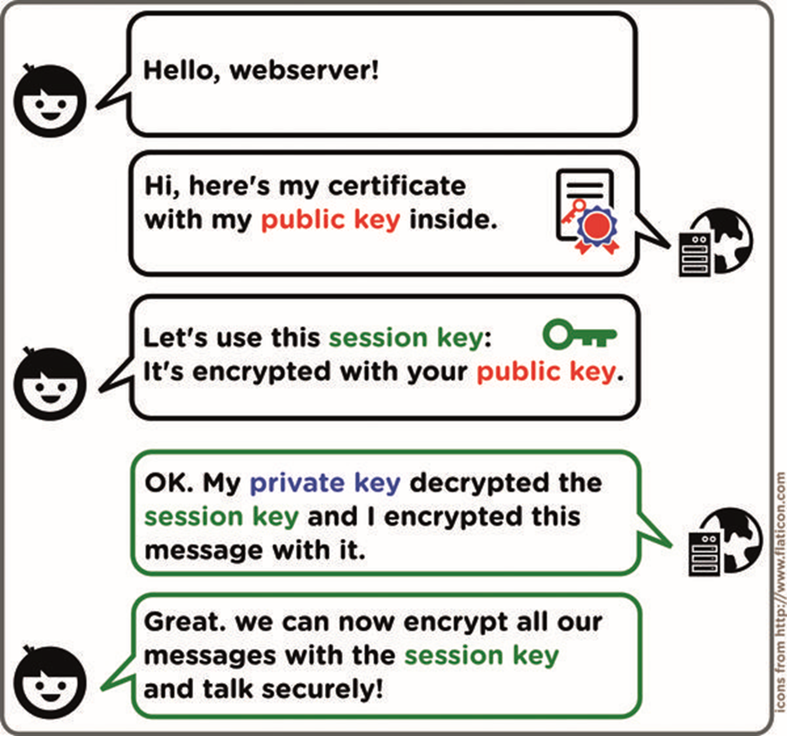
Review of TLS (SSL) Certificate
SSL stands for Secure Socket Layer – the standard technology for keeping an internet connection secure and encrypted.
TLS stands for Transport Layer Security and is really just an updated, more secure version of SSL.
LDAP uses TLS (as you can tell from its config variables), but most people just talk about “SSL Certificates.”
An SSL Certificate is a small file containing a cryptographic public key linked to the server’s information.
This is sent to the client so it can be used to encrypt the connection
If the certificate was signed by a Certification Authority (CA) the client recognizes, the client can validate what the server provides to prove the identity of the server.
There are common large certification authorities which are widely recognized and that your client probably already has information from – these help you be trusted
But you can also create a certificate yourself – a “self-signed certificate.”
Each Certificate also has a matching private key kept secret by the server.
The client uses the public key to create a session key which the server then decrypts with the private key and then both parties can use the session key to encrypt their traffic.

Slide 11
Start slapd (or any other daemon) automatically
Depending on how we set things up, we might not even have an account to log in with if slapd isn’t running!
For a lot of services, we want them running on boot
Just like with starting, stopping, restarting, and getting the status of services, you’ll use systemctl to enable or disable a service:
Start slapd on boot:
systemctl enable slapd
Make it so slapd no longer runs on boot:
systemctl disable slapd
You might want to be careful though – if there are problems with your set-up, having a service automatically start on boot can cause you headaches.
To disable a service from starting on boot, and stop it immediately, use:
systemctl disable –now slapd

